Slide 1
Project Update
Jacob Heglund
AE 598 – Advanced Navigation Systems

Slide 2
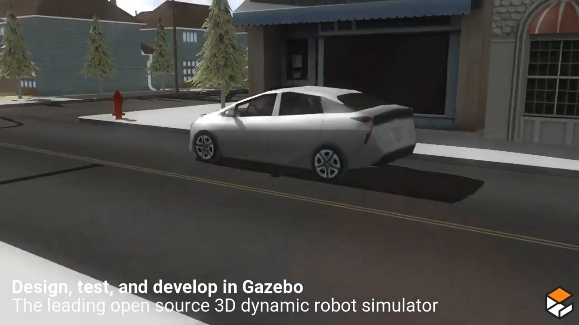
Autonomous Cars
Original Project Goal
Develop a simulated autonomous car that could solve the navigation task in an environment filled with obstacles
How hard could it be?
https://www.youtube.com/watch?v=97JRYhKLhSY

Slide 3
Autonomous Cars
After extensive searching
Many freely available autonomous car simulators do not have good enough documentation to get them working
Some don’t make their world files easily available
A simulation that “does it all” isn’t necessary to develop individual components of an autonomous car

Slide 4
Autonomous Cars
Amended Project Goal
Develop individual components necessary for the operation of an autonomous car
What components can I develop with available resources?
Hierarchy of Autonomous Cars
Main Goals
High Level Navigation
Localization on a map using GPS and Particle Filter
Low Level Navigation
Object recognition (lanes, obstacles, traffic signs)
Driving using vision alone (transfer learning from human)
https://towardsdatascience.com/how-self-driving-cars-get-from-a-to-b-f18b1fc12044

Slide 5
Autonomous Cars
High Level Navigation
Localization on a map using GPS and Particle Filter
I will be developing an appropriate simulation to implement this part
Want to incorporate map data so the vehicle follows a realistic trajectory
Want to incorporate realistic uncertainty in GPS measurements

Slide 6
Autonomous Cars
Low Level Navigation (vision tasks)
Object recognition (lane keeping)
Will attempt to solve the lane recognition problem using classical CV methods first, then deep learning
This allows a comparison of the effectiveness of classical and deep learning techniques for the same problem
https://www.udacity.com/course/self-driving-car-engineer-nanodegree--nd013#
https://xingangpan.github.io/projects/CULane.html

Slide 7
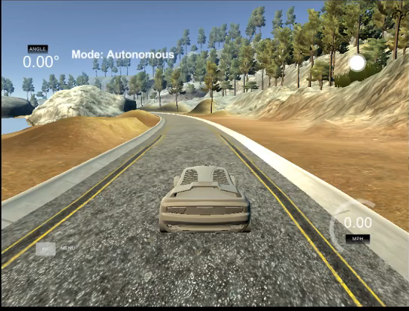
Autonomous Cars
Low Level Navigation
Driving using vision alone
transfer learning from human examples
Simulator has 3 camera sensors, data can be collected
https://www.udacity.com/course/self-driving-car-engineer-nanodegree--nd013#
https://xingangpan.github.io/projects/CULane.html

Slide 8
Autonomous Cars

